Slide 1
Digital Portfolio
STUDENT NAME :ABARNA A
REGISTER NO AND NMID : 2422K1966 & asbru3y2422K1966
DEPARTMENT : Bsc Cs(COMPUTER SCIENCE)
COLLEGE : COLLEGE/ UNIVERSITY : SRI RAMALINGAM SOWDAMBIGAI COLLEGE OF SCIENCE AND COMMERCE & BHARATHIYAR UNIVERSITY

Slide 2
PROJECT TITLE
Digital portfolio

Slide 3


AGENDA
Problem Statement
Project Overview
End Users
Tools and Technologies
Portfolio design and Layout
Features and Functionality
Results and Screenshots
Conclusion
Github Link
3/21/2024 Annual Review

Slide 4

PROBLEM STATEMENT
"Design a visually stunning editorial portrait that showcases a confident Asian man in a stylish, high-fashion setting, incorporating specific attire and props while conveying modern elegance.
"Create a captivating image that combines fashion and sophistication, featuring a confident Asian man seated on a bold red chair against a minimalist brown backdrop with subtle typography, highlighting his stylish ensemble and accessories.
"Develop a high-end editorial portrait that captures the essence of modern style and sophistication, featuring a confident Asian man dressed in a brown checkered blazer, white shirt, and tailored trousers, accessorized with round sunglasses and a smartwatch.

Slide 5

PROJECT OVERVIEW
Digital Portfolio Project
Goal: Create a professional online presence showcasing skills, experience, and accomplishments.
Objectives:
1. Establish online presence
2. Improve visibility
3. Demonstrate expertise
Target Audience
Potential employers, clients, collaborators
Key Features :
1. Home page
2. About page
3. Work samples
4. Skills and expertise
5. Contact information
Timeline:
1. Research and planning
2. Design and development
. 3. Launch and promotion

Slide 6

WHO ARE THE END USERS?
Potential employers:
Hiring managers, recruiters, or HR professionals
Clients:
Individuals or businesses looking for services or expertise.
Collaborators:
Other professionals, partners, or team members.
These users want to:
1. View work samples: Showcase of skills and experience.
2. Learn about expertise: Understand capabilities and areas of specialization.
3. Contact: Get in touch for potential opportunities or collaborations

Slide 7

TOOLS AND TECHNIQUES
Tools :
1. Google Drive: Store and organize artifacts in a shared folder.
2. Website builders: Wix, Squarespace, or WordPress for custom digital portfolios.
3. Book Creator: Collect and combine learning artifacts with audio recording and reflection.
4. Seesaw: Create digital portfolios for students to collect, curate, and publish artifacts.
Best Practices :
1. Keep it fresh: Regularly update your portfolio with new projects and skills.
2. Curate content: Select samples that reflect your work and goals.
3. Make it easy to navigate: Organize your portfolio for easy viewing.

Slide 8
POTFOLIO DESIGN AND LAYOUT
Portfolio Design Tips:
1. Keep it simple and clean: Avoid clutter.
2. Use consistent branding: Same visual identity throughout.
3. Clear navigation: Easy to find what visitors need.
4. Showcase best work: Curate strongest projects.
5. High-quality images: Use high-resolution images.
6. Easy to scan: Use headings and bullet points.
8

Slide 9
FEATURES AND FUNCTIONALITY
Features:
Project showcases
Image/video galleries
Case studies
Skills & expertise
Testimonials
Blog/news section
Facilities:
Customization
Easy updating
SEO
Responsive design
Contact/feedback mechanisms

Slide 10

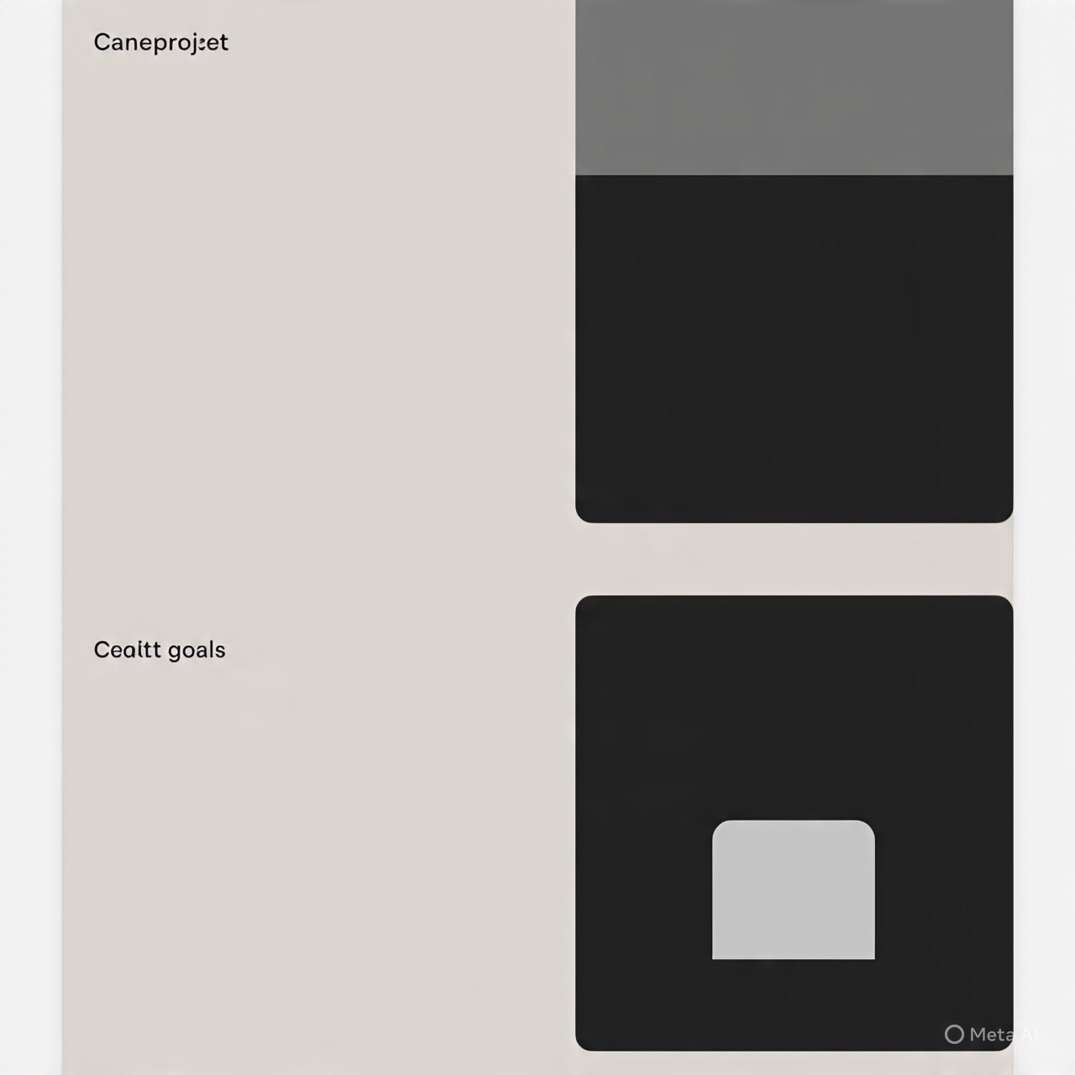
RESULTS AND SCREENSHOTS
Results :
1. Professional online presence: A well-designed digital portfolio showcases your skills and experience.
2. Increased visibility: Potential employers, clients, or collaborators can easily find and view your work.
3. Improved credibility: A polished portfolio demonstrates your expertise and professionalism.
A screenshot of a digital portfolio might show:
1. Home page: A clean and simple design with a brief introduction and navigation menu.
2.Project showcases: A gallery of images or videos showcasing completed projects.
3. Case study: A detailed examination of a specific project, including challenges, solutions, and results .
3/21/2024 Annual Review
10

Slide 11
CONCLUSION
A well-designed digital portfolio is essential for showcasing your skills, experience, and accomplishments. By incorporating features like project showcases, case studies, and testimonials, you can demonstrate your expertise and professionalism to potential employers, clients, or collaborators. By following guidelines such as defining your goals, choosing the right platform, curating your content, and designing for usability, you can create a digital portfolio that effectively showcases your skills and helps you achieve your goals.
11

Slide 12
Thanks you

